Slide 1


Project Schedule Management
1

Slide 2




Table of content
Schedule Management Overview
Schedule Management Processes
Schedule Management in Agile
Case Studies in FPT Summary

Slide 3


Objective
After this session, the attendees shall:
Understand the important of schedule management
Know how to create a realistic project schedule
Learn techniques to control schedule effectively
Understand schedule management in Agile project

Slide 4
Schedule Management Overview

Slide 5
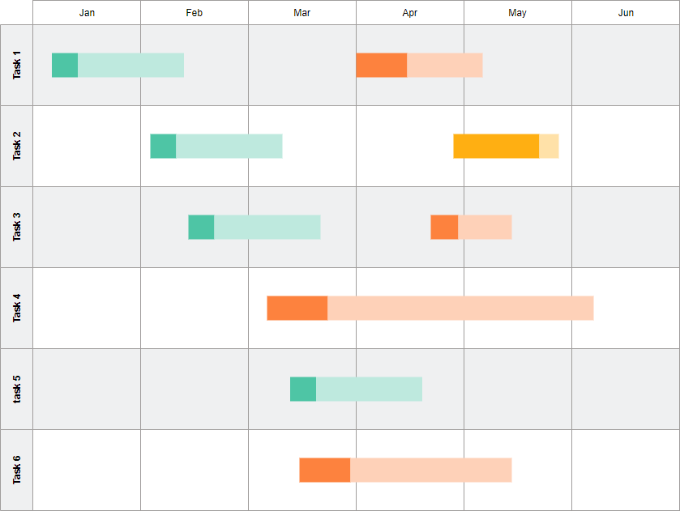
Why Schedule Management?
» Effective project scheduling is a critical component of successful time management.
» A schedule usually includes:
» Planned start date
» Planned finish date
» Duration
» Resources assigned to each activity
» Benefit:
» Assists with tracking, reporting on, and communicating progress
» Ensures everyone is on the same page as far as tasks, dependencies, and deadlines
» Helps highlight issues and concerns, such as a lack of resources
» Helps identify task relationships
» Can be used to monitor progress and identify issues early

Slide 6









Key Processes in Schedule Management
Schedule & Calendar
Estimate
Network Diagram
Activity List & Milestones
Schedule Management Plan

Slide 7
Plan Schedule Management

Slide 8
What included in Schedule Management Plan?
Schedule Management Plan provides guidance and direction on HOW the project schedule
will be managed throughout the project
Schedule model development Scheduling methodology Scheduling software
Iteration length (Adaptive)
How estimate should be stated
Estimate in month, day or hours? Estimate both effort & duration? Level of accuracy
Model
Rule
Monitor
Report
How to monitor
Performance measure & threshold Process to check schedule variances Process for schedule change control
How to report
Type of report Report format Report frequency
43e-BM/HR/HDCV/FSOFT V1.2 - ©FPT SOFTWARE – Corporate Training Center
8
3/18/2021

Slide 9



Define Activities
3/18/2021
43e-BM/HR/HDCV/FSOFT V1.2 - ©FPT SOFTWARE – Corporate Training Center
9

Slide 10
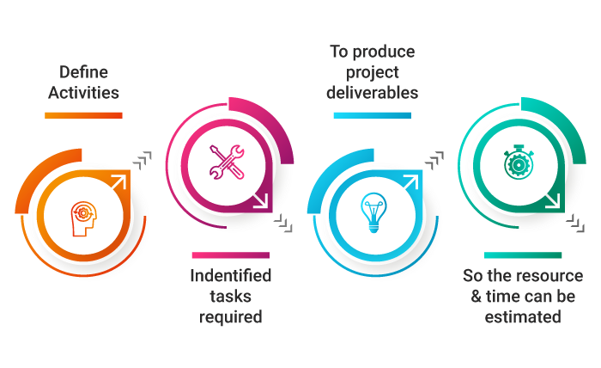
How to identify activities?
Where should we start from?
Scope baseline: Scope Statement, WBS, WBS Dictionary
Who should define activities?
Persons responsible to execute them
How small of activities?
Able to estimate cost & time
How much activities to identify?
Rolling wave planning: work in near term is planned in details, work in future is planned at a higher level
43e-BM/HR/HDCV/FSOFT V1.2 - ©FPT SOFTWARE – Corporate Training Center 10
3/18/2021

Slide 11
Sequence Activities

Slide 12
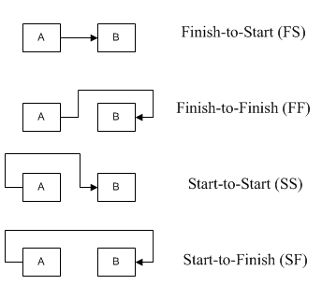
Activity Logical Relationship
» Finish to Start (FS): Task B can not start until Task A finishes
» Finish to Finish (FF): Task B can not finish until Task A finishes
» Start to Start (SS): Task B can not start until Task A starts
» Start to Finish (SF): Task B can not finish until Task A starts

Slide 13
Activity Dependencies
Precedency relationship
Done by internal team member
Inside project team control
Project & Non-project activities
Done by external people
Outside project control
Also known as Hard logic
Legally or contractually required
Inherent in the nature of work
Many ways to define sequence
Based on best practice
Defined by project team
Internal Dependency
Mandatory Dependency
External Dependency
Discretionary Dependency

Slide 14
Lead & Lags
» Lead: Amount of time where successor activity can
be advanced with regard to predecessor activity.
Lag: Amount of time whereby a successor activity will be delayed with regard to a predecessor activity
Design
FS – 2 week (Lead)
Coding
Sign contract
FS – 2 week (Lag)
Team Onboard

Slide 15
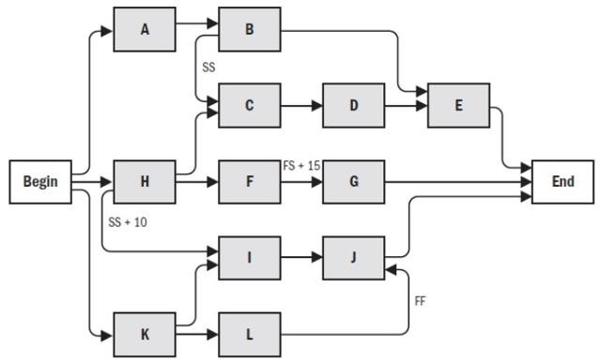
Network Diagram
» It is a graphical representation of logical relationship between activities
» Shows dependencies among schedule activities

Slide 16
Estimate
Activity Duration

Slide 17
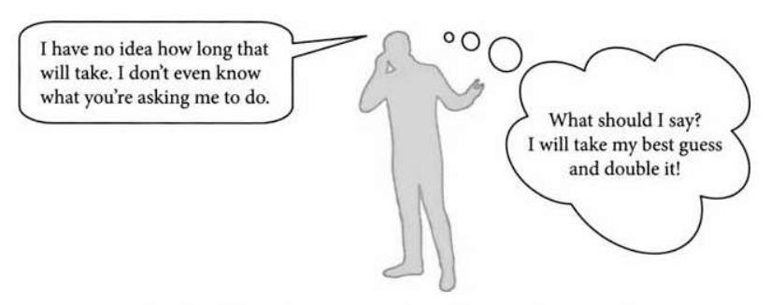
What impact to Activity Duration Estimate?
» To estimate work periods needed to complete each activity with estimated resources
Activity Resource Estimate Method
Activity List
Activity Attribute
Milestones
Resource Requirement
Resource Calendar
Project Team Assignment
1. Estimate approach

Slide 18
Activity Duration Estimate Techniques
» Expert Judgement
» Analogous
» Parametric
» Three-point
» Bottom-up
» Data Analysis
» Alternative Analysis
» Reserve Analysis

Slide 19
Develop Schedule

Slide 20
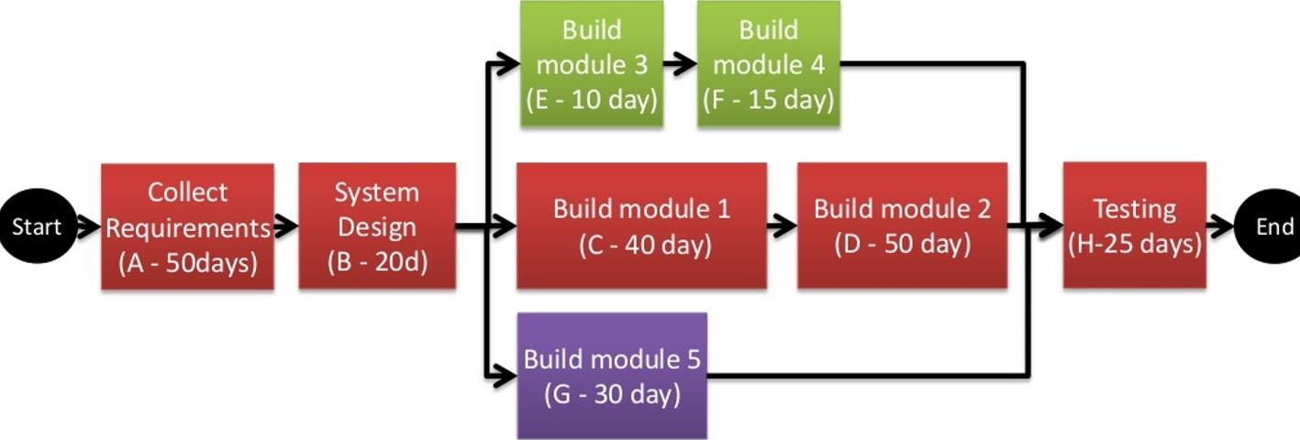
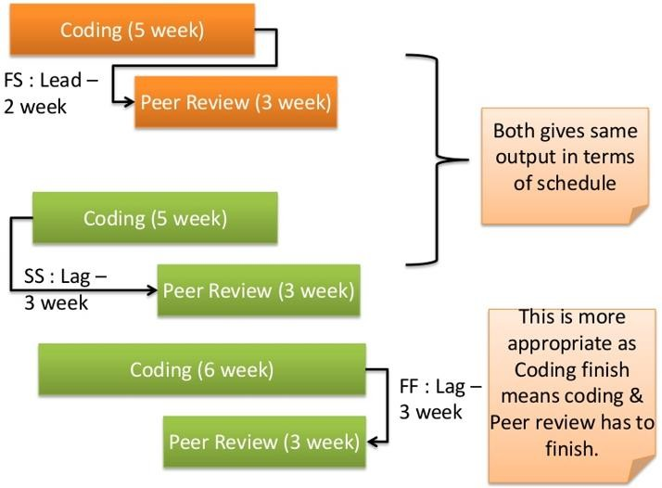
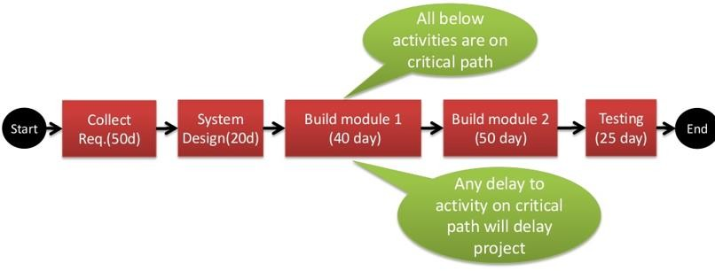
Finalize Project Schedule
» Use existing schedule model (template)
» Update with information from previous processes (activity, sequencing, resources, duration etc.)
Schedule Network Analysis
Utilize Leads & Lags
Critical Path Method

Slide 21
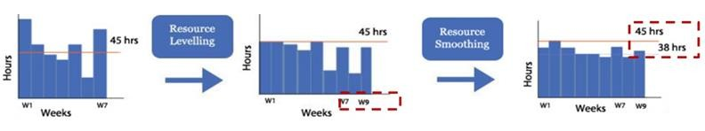
Resource Optimization Techniques
» How to allocate resources in a way to bring maximum output
» Resource leveling:
» Timelines extended to adjust resource constraint
» Change Critical Path -> change duration
» Resource smoothing:
» Critical path is not changed & completion date is same
» Activities may be delayed within their free & total float
Activities changed by utilizing float based on critical path constraints
Duration changed due to resource constraints

Slide 22
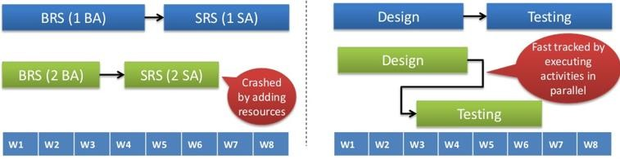
Schedule Compression Techniques
» Reduce schedule duration without reducing project scope
» Adhere to schedule constraints, imposed dates, or other schedule objectives
» Crashing: Shorten schedule duration for least cost by adding resources
» Fast tracking: Activities done in sequence are performed in parallel for at least some portion of
their duration

Slide 23
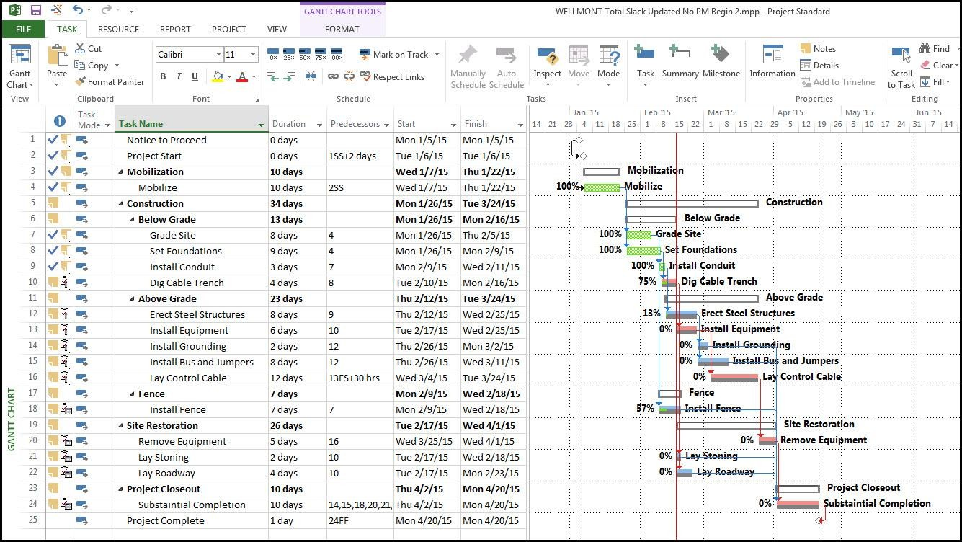
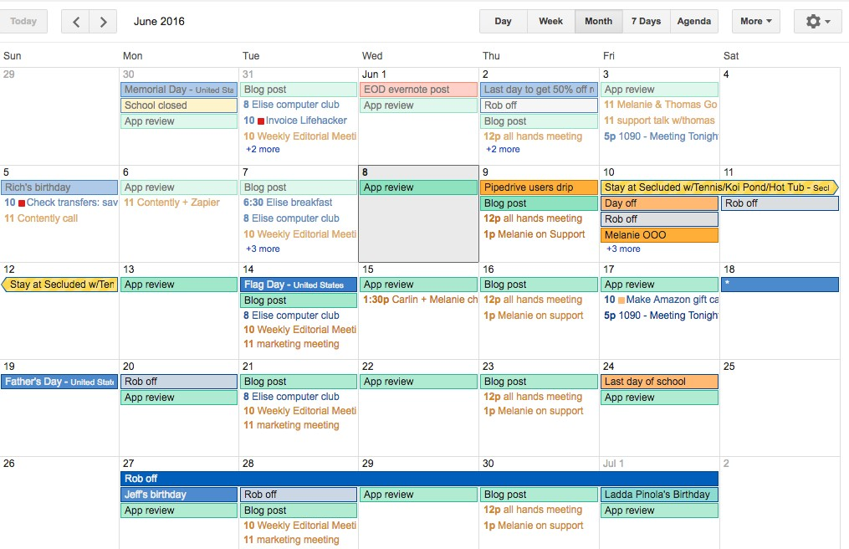
Develop Schedule Output
» Schedule baseline
» Schedule Data
» Project Schedule & Project Calendar

Slide 24
Control Schedule

Slide 25
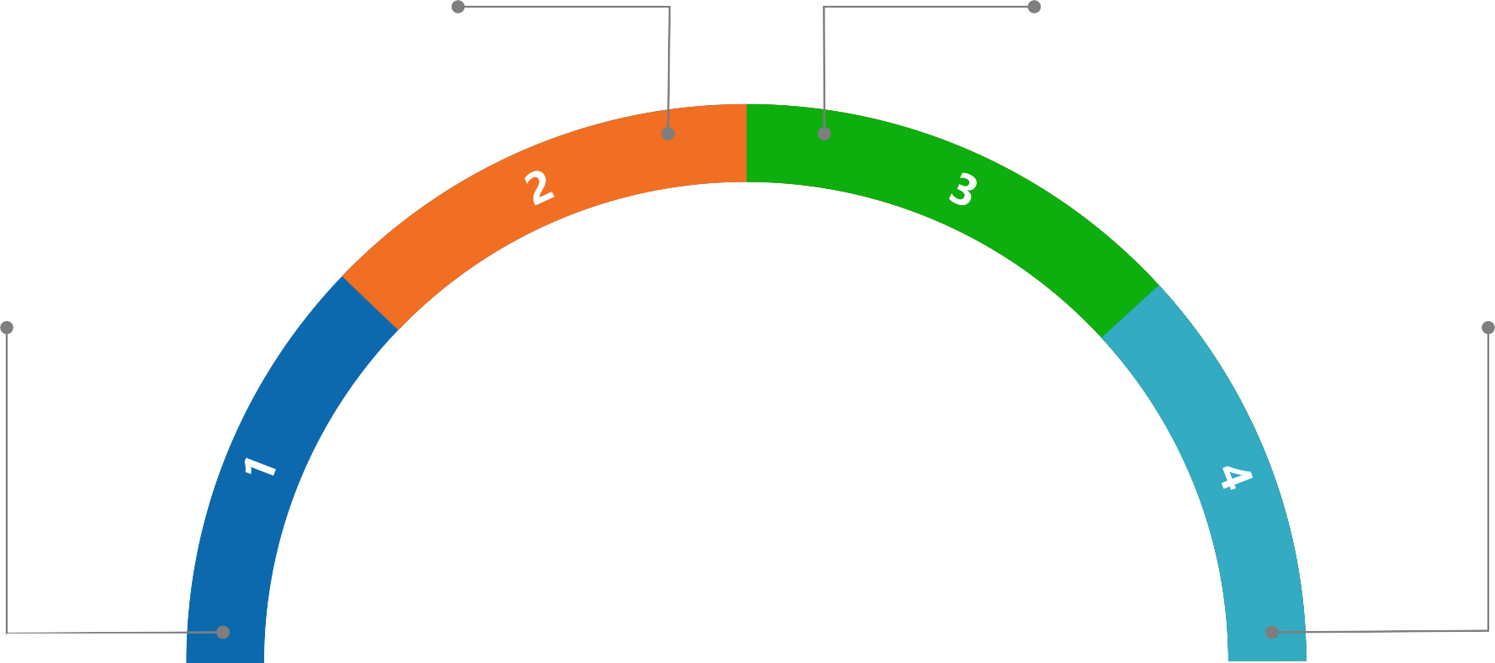

How to control schedule?
Influence factors that cause
schedule changes
Identify when schedule has changed
Determine Current Status
Manage the change
Control Schedule

Slide 26
Tools & Techniques for controlling schedule
Performance Reviews
Measure, compare, & analyze schedule performance. E.g., Actual start & finish dates, % complete & remaining duration for work in progress
Schedule Compression
Crashing: Adding resources
Fast tracking: Performing activities in parallel
Performance
Review
Schedule Compression
Project Management Software
Project Management Software
Microsoft Project Plan, Gantt Chart, Excel etc. to generate activities, duration, resource, network diagram
Tools for controlling schedule
Leads & Lags
Based on the activities dependencies to
optimize leads & lags
Leads and Lags
Critical Path
Method
Critical Path Method
Resource Leveling: Adjust deadline
Resource Smoothing: Adjust activities
Resource Optimization
Resource Optimization Techniques
Resource Leveling: Adjust deadline Resource Smoothing: Adjust activities

Slide 27
Schedule Management in Agile

Slide 28
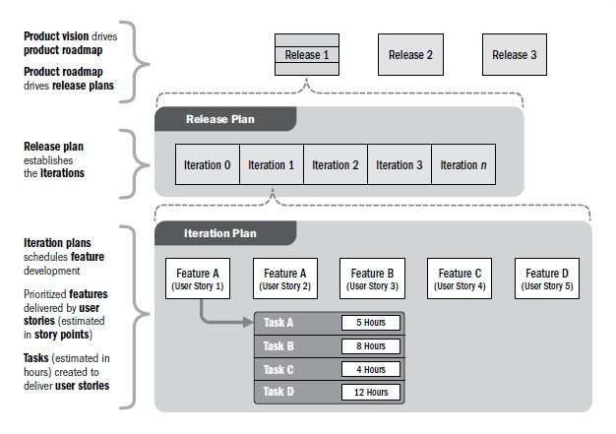
How is schedule developed in Agile?

Slide 29
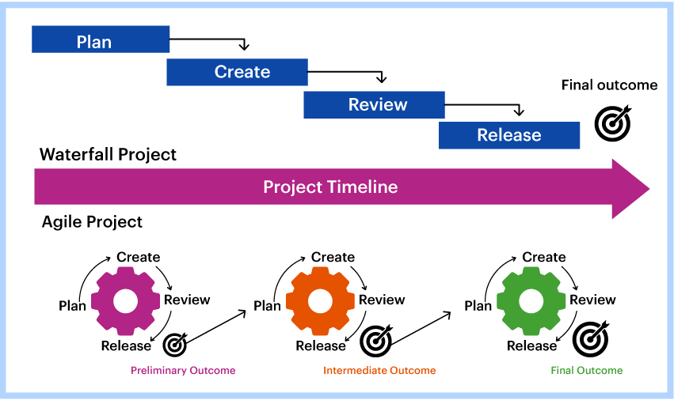
Difference in timeline between Agile & Waterfall

Slide 30
Case Study: Evaluate Estimate
Bidding by Expert
» In bidding phase, the SA estimated the activity duration based on his capability and it looks optimistic. The project can be done in within 6 months
» In execution phase, the delivery project team re-estimated and complained
that the schedule is unrealistic. It must be done in 1 year @@
» Consequence: FSU/OB had to work together and invest on the project 30MM
» Lesson Learned: Use right estimate approach with review. The person who will run the project should involve in the estimation

Slide 31
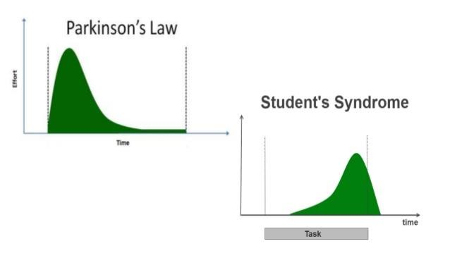
Case Study: Deal with Deadline
» Be careful with student syndrome and Parkinson’s Law:
» Need to monitor the individual’s performance periodically

Slide 32
Summary
In this course, you already learned:
» Schedule Management Overview
» What is Schedule Management
» Why Schedule Management
» Schedule Management Process
» Define Activities
» Sequence Activities
» Estimate Activities Duration
» Develop Schedule
» Control Schedule
» Schedule Management in Agile
» Product roadmap
» Product backlog
» Work priority
» Estimate Activity Duration
» Case Studies in FPT

Slide 33
Thank You !

